Slide 1


















Slide 2


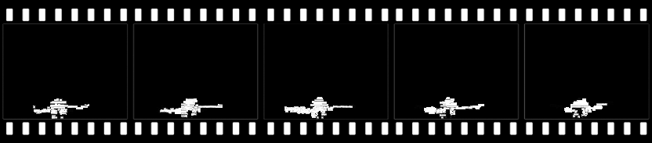
Depth maps 1

Slide 3

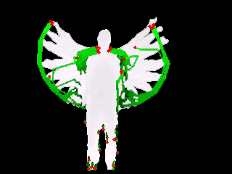


Y
X
Z

Slide 4
Depth maps 1
… …
Depth maps m
Projection
Intensity representations
Intensity representations
Front
Side
Top
Front
Side
Top
Feature Extraction
Dense trajectories
Codebook
Bag-of-Words model
Codebook
Codebook
Quantization
Hard-assignment
Histogram database
Training/Tesing using SVM
Histogram Intersection kernel,
One-vs-All strategy
Classifiers

